Slide 1




Fresher Learning Program
Teradata Training – Day 1

Slide 2
Module Object
RDBMS Concepts
Teradata Overview
Teradata and Data warehouse
Components and Architecture
Teradata Utiltities

Slide 3
RDBMS Concepts What is a Relational Database?
What is a Relation Database ?
A database is a collection of permanently stored data that is:
Logically related → data relates to other data
Shared → many users may access data.
Protected → access to data is controlled.
Managed → data integrity and value is maintained.
Relational databases are based on the relational model, which is founded on mathematical Set Theory.

Slide 4
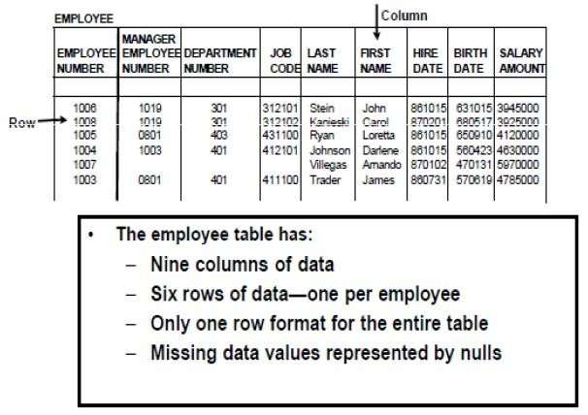
RDBMS Concepts Relational Database
Relational Databases present data as of a set of logically related tables.
A table is a 2 dimensional representation of data that consists of rows & columns.

Slide 5
RDBMS Concepts → Data Modeling
3NF (Third Normal Form):-
A normalized model includes:-
Entities
Attributes
Relationships
Rules of Normalization:-
1st NF → Each & every attribute within an entity has 1 & only 1 value.
No repeating groups are allowed within entities.
2nd NF →Entity must conform to the 1st NF rules.
Every non-key attribute within an entity is fully dependant upon the entire key of the entity & not a subset of the key
3rd NF→ Entity must conform to the 1st NF & 2nd NF rules.
No non-key attributes within an entity is functionally dependant upon another non-key attribute within the same entity.
Star Schema & Snowflake Schema:
A Star schema model includes:-
Facts & Dimensions

Slide 6
RDBMS Concepts → Data Modeling
Normalization:
Process of reducing a complex data structure into a simple,
stable model.
Involves removing redundant attributes, keys, and relationships from the data model.
Star Schema:
▪Process of having fewer entities
▪Involves a greater level of denormalization

Slide 7
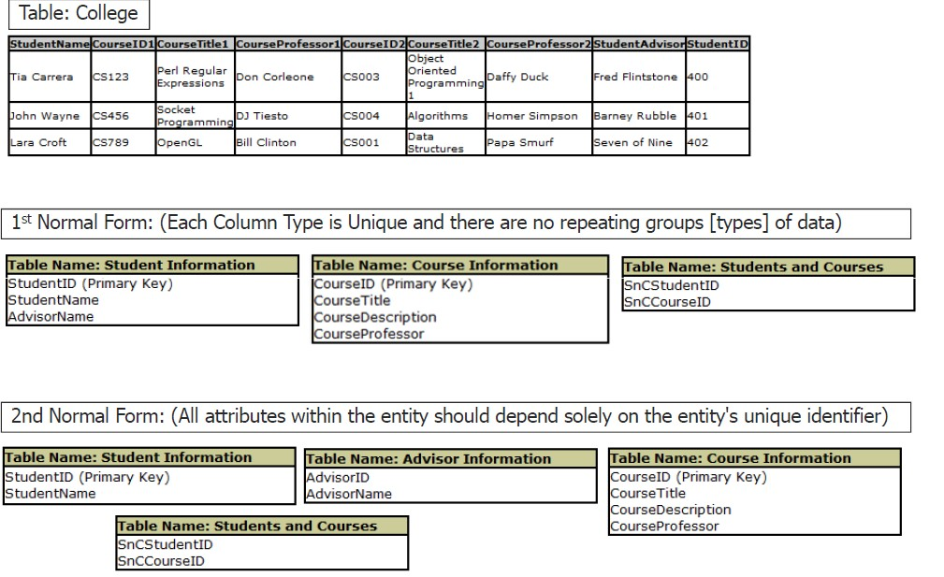
Example on Normalization

Slide 8
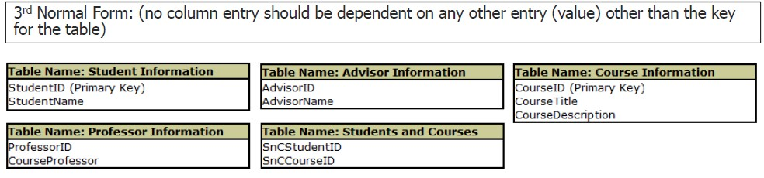
Example on Normalization

Slide 9
RDBMS Concepts – Primary Key
Primary Key (PK) values uniquely identify each row in a table.
Primary Key Rules
– A Primary Key is required for every table.
– Only one Primary Key is allowed in a table.
– Primary Keys may consist of one or more columns.
– Primary Keys cannot have duplicate values (ND).
– Primary Keys cannot be null (NN).
– Primary Keys are considered “non-changing” values (NC).

Slide 10
RDBMS Concepts – Primary Key
Foreign Key (FK) values model relationships.
FKs are optional.
More than one FK is allowed per table.
FKs can be made up of more than one column.
Duplicate values may be allowed.
Missing (null) FK values may be allowed.
Changes to FKs are allowed.
Each FK value must exist somewhere as a PK value (i.e.
have referential integrity).

Slide 11
RDBMS Concepts – Relational Advantages
Advantages of a Relational Database compared to other database methodologies include:
More flexible than other types
Allowing businesses to quickly respond to changing conditions
Being data-driven vs. application driven
Modeling the business, not the processes
Makes applications easier to build because the data does more of the work
Being easy to understand
Supporting trend toward end-user computing
No need to know the access path
Solidly founded in set theory

Slide 12
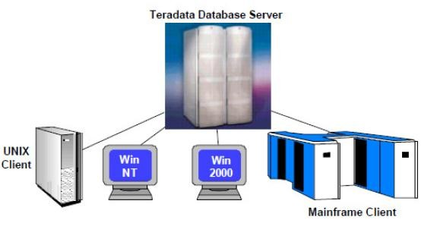
Teradata Overview
Teradata is a Relational Database Management System (RDBMS) that drives an company’s data warehouse.
An open system, compliant with industry ANSI standards.
Capable of supporting many concurrent users from various client platforms (over a TCP/IP or IBM channel connection).
Runs on various OS like Novell SUSE Linux, MS Windows Enterprise Server & other traditional OS. Hence it is considered an open architecture
Built on a parallel architecture.

Slide 13
Teradata Overview – Why Teradata?
Single Data Store
Scalability
Unconditional Parallelism (parallel architecture)
Parallel aware optimizer

Slide 14
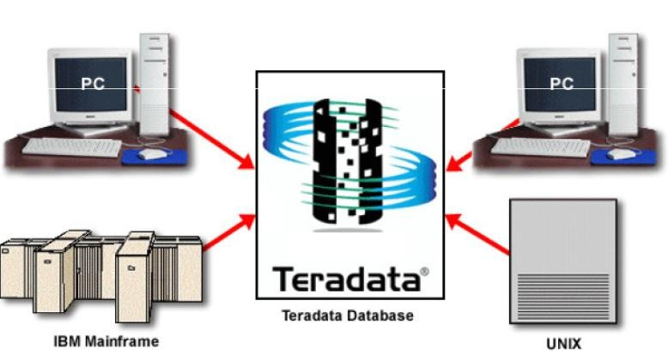
Teradata – Single Data Store
Teradata DB acts as a single data store, with multiple client applications making
inquiries against it concurrently.
Instead of replicating a database for different purpose, with the Teradata DB you store the data once & use it for many applications.

Slide 15
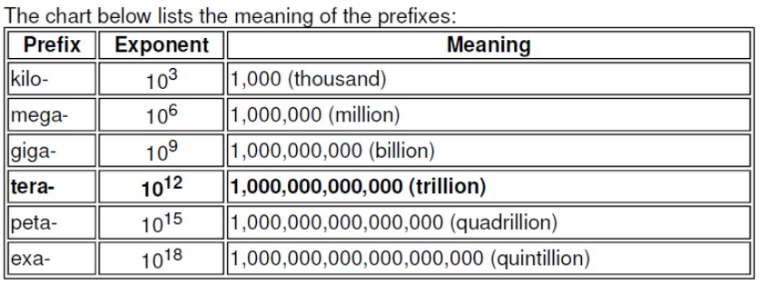
Teradata – Scalability
“Linear Scalability” means that as you add components to the system, the performance increase is linear. Linear Scalability enables the system to grow to support more users/data/queries/complexity of queries without experiencing performance degradation.
Teradata DB was the 1st commercial database system to scale & support a trillion bytes of data
Teradata DB can scale from 100 GB’s to over 100+ petabytes of data.

Slide 16
Teradata Overview – Designed for Today’s Business
Teradata meets the business needs of today & tomorrow with:
Relational model - standard for database design.
Huge capacity (billions of rows, terabytes of data).
High performance parallel processing
Single database server for multiple clients (“Single Version of the Truth”).
Network and mainframe connectivity.
Industry standard access language (SQL).
Manageable growth through modularity.
Fault tolerance at all levels of hardware and software.
Data integrity and reliability.

Slide 17
Teradata Overview – Review
Designed to process large quantities of detail data.
Ideal for data warehouse applications.
Parallelism makes easy access to very large tables possible.
Open architecture - uses industry standard components.
Scalability - Performance increase is linear as components are added.
Runs as a database server to client applications.
➢Runs on multiple hardware platforms.

Slide 18
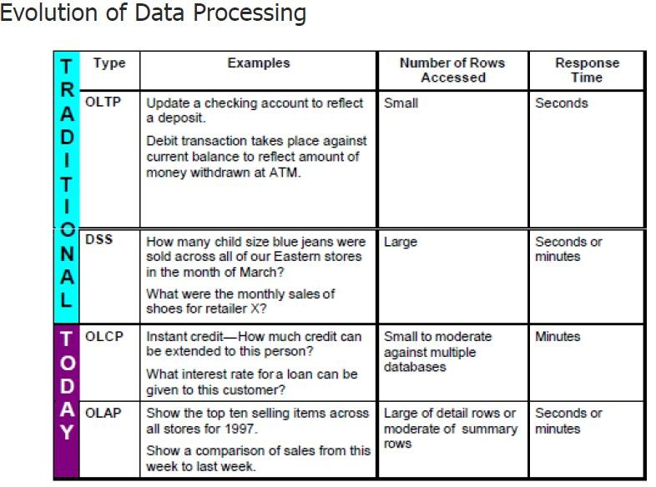
Teradata and Data Warehouse

Slide 19
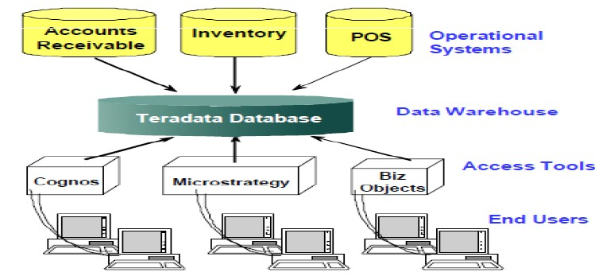
Teradata & Data Warehouse
Data Warehouse:
A central, enterprise-wide database that contains information extracted from operational systems.
Based on enterprise wide model
Can begin small but may grow large rapidly
Populated by extraction/loading of data from operational systems
Responds to end-user “what if” queries

Slide 20
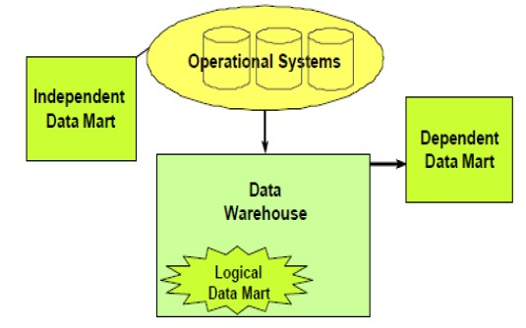
Teradata & Data Warehouse
Data marts:
A data mart is a special purpose subset of enterprise data for a particular function or
application. It may contain detail or summary data or both.
Data mart types:
Independent—created directly from operational systems to a separate physical datastore.
Logical—exists as a subset of existing data warehouse.
Dependent—created from data warehouse to a separate physical data store.

Slide 21
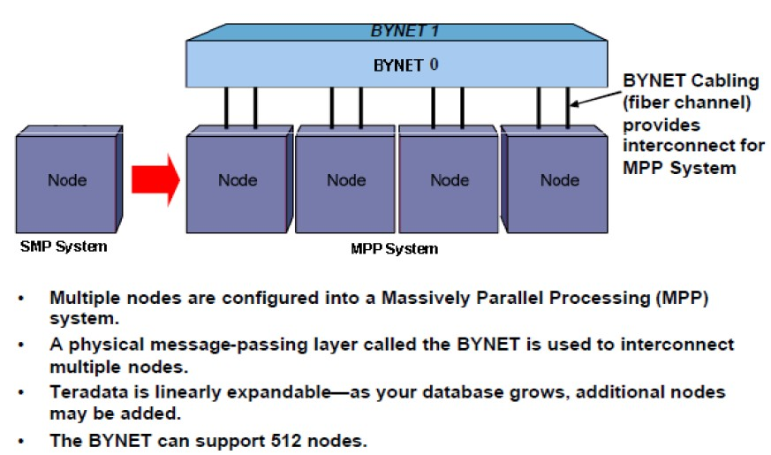
Teradata → SMP v/s MPP
SMP → Symmetric Multiprocessing Platforms manage terabytes of data to support an entry-level data warehousing system.
MPP → Massively Parallel Processing systems can manage hundreds of petabytes of data. You can start with a couple of nodes

Slide 22
Teradata and Data Warehouse
Active Data Warehousing
Performance
Response time within seconds.
Scalability
Support for large amounts of detailed data, mixed workloads (both tactical and strategic queries) for mission critical applications, and concurrent users.
Availability and Reliability
– 7 x 24
Data Freshness
– Accurate, up to the minute, data including access to operational data store level information.

Slide 23
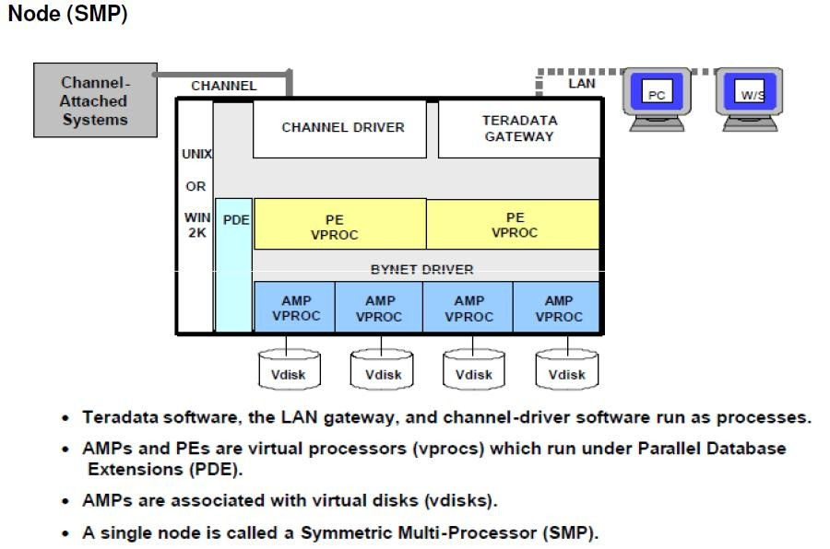
Teradata → Components and Architecture

Slide 24
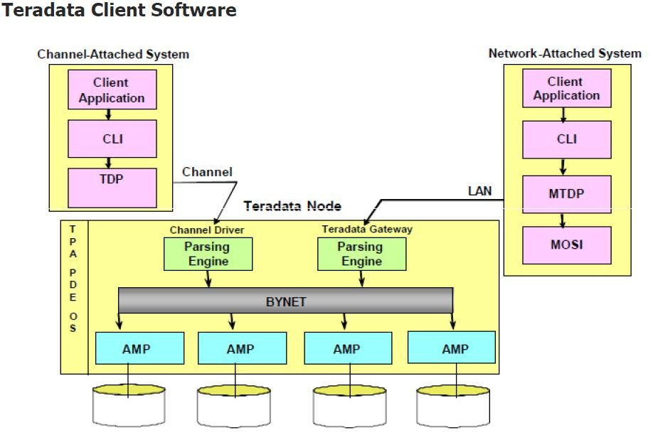
Teradata → Components and Architecture

Slide 25
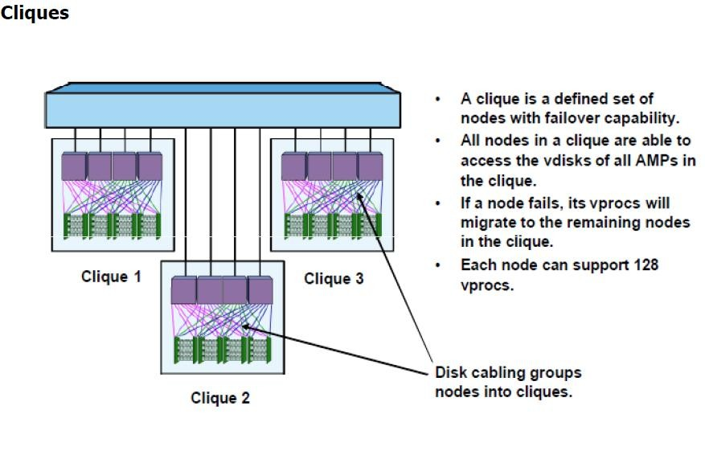
Components and Architecture

Slide 26
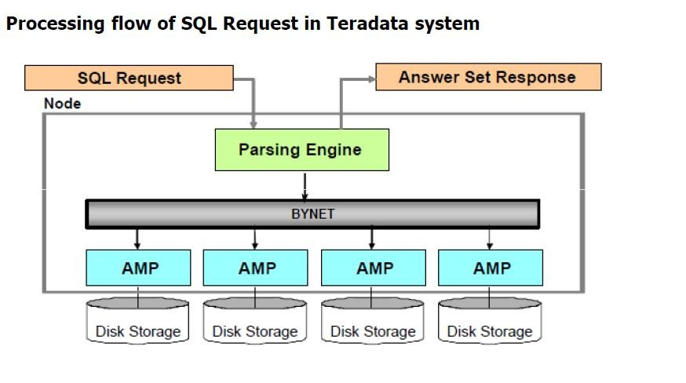
Components and Architecture

Slide 27
Components and Architecture
Major Components of a Teradata System
Parsing Engine (PE)
The Parsing Engine (PE) is a component that interprets SQL requests, receives input records, and passes data. To do that it sends the messages through the BYNET to the AMPs.
BYNET
The BYNET is the message-passing layer. It determines which AMP(s) (Access Module Processor) should receive a message.
Access Module Processor (AMP)
The AMP is a virtual processor (vproc) designed for and dedicated to managing a portion of the entire database. It performs all database management functions such as sorting, aggregating, and formatting data. The AMP receives data from the PE, formats rows, and distributes them to the disk storage units it controls. The AMP also retrieves the rows requested by the Parsing Engine.
Disks
Disks are disk drives associated with an AMP that store the data rows. On current systems, they are implemented using a disk array

Slide 28
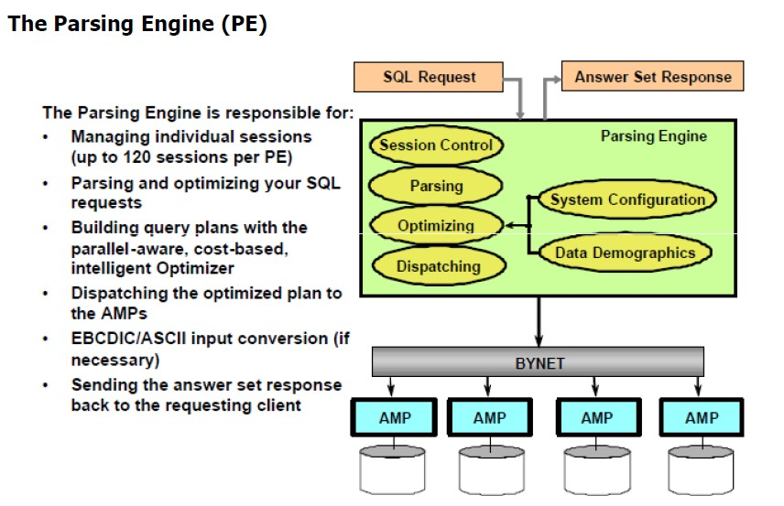
Components and Architecture

Slide 29
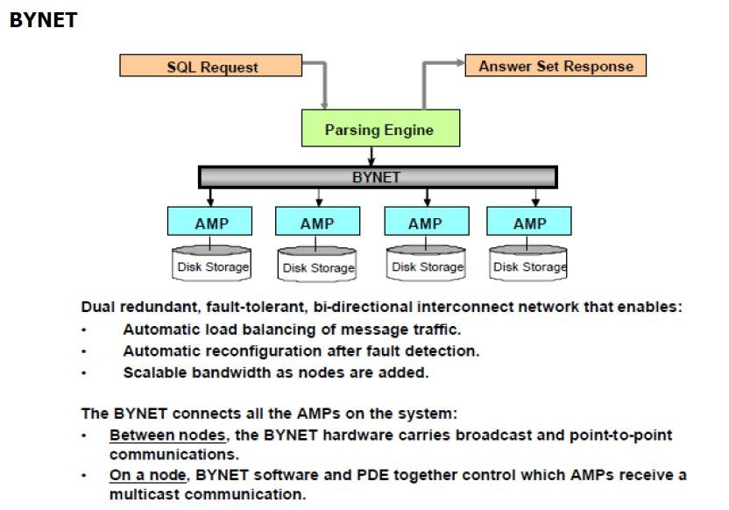
Components and Architecture

Slide 30
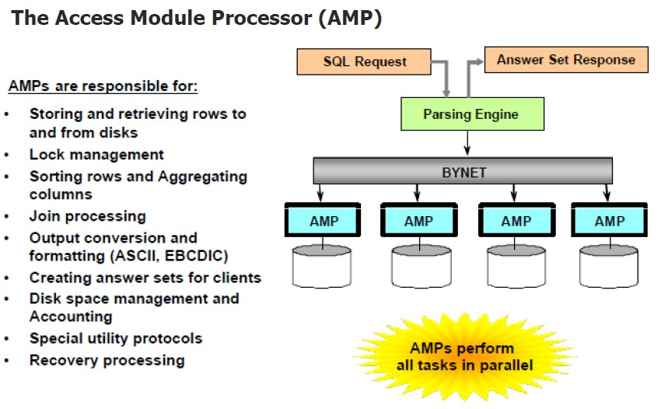
Components and Architecture

Slide 31
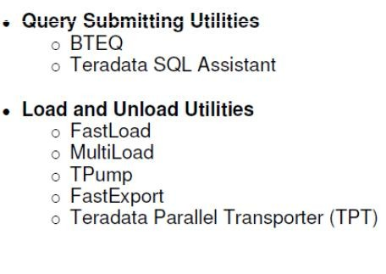
Teradata Utilities
Teradata utilities leverage the Teradata Database’s high performance capabilities &
are fully parallel & scalable. They run on both SMP & MPP systems.
Utilities which are commonly used by all Teradata Developer’:-

Slide 32
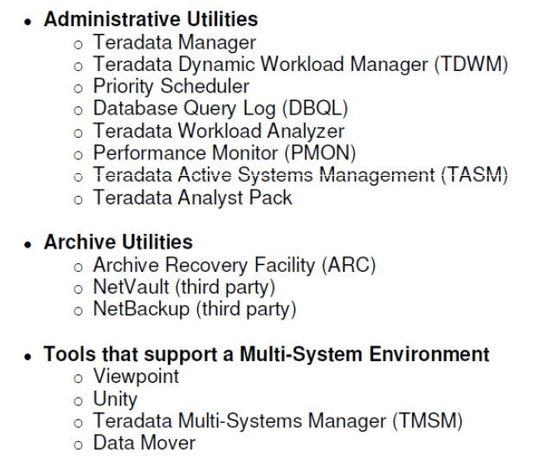
Teradata Utilities
Utilities which are commonly used by all Teradata DBA’s:-

Slide 33
Q & A

Slide 34
Review Questions
Match each term with its definition below:
1. Database
2. Table
3. Relational database
4. Primary Key
5. Null
6. Foreign Key
a - A set of columns which uniquely identify a row. b - A set of logically related tables.
c - One or more columns that are a PK somewhere in the database. d - The absence of a value.
e - A two-dimensional array of rows and columns.
f - A collection of permanently stored data.

Slide 35
Answers
Match each term with its definition below:
_f_ 1. Database
_e_ 2. Table
_b_ 3. Relational database
_a_ 4. Primary Key
_d_ 5. Null
_c_ 6. Foreign Key
a - A set of columns which uniquely identify a row
b - A set of logically related tables
c - One or more columns that are a PK somewhere in the database d - The absence of a value
e - A two-dimensional array of rows and columns f - A collection of permanently stored data

Slide 36

QUIZ
1. Which type of database is built around both set processing and row-at-a-time processing?
A. network
B. data mart
C. relational
D. hierarchical
E. inverted list
2.Which three are terms that are associated with star schema and dimensional modeling? (Choose three.)
A. facts
B. entities
C. attributes
D. snowflakes
E. dimensions
F. relationships
Option C
Option A,D,E

Slide 37
QUIZ
3.What is a characteristic of a dependent data mart?
A. contains unique data
B. is the system of record
C. sourced from operational systems
D. subset of data often used by a department
Option D
4.What is used by PEs and AMPs for internal communications?
A. the YNET
B. the BYNET
C. a proprietary LAN
D. an inter-node WAN
Option B

Slide 38
Module 1: Lab Exercise
Create a copy of the table employee_sales.employee using the subquery form with a “SELECT *”, populating it with data. Show the definition of it to check primary index. Then perform a SELECT * against it.
Use a subquery form to create a table, with data, from a left outer join against Employee, Department and Job. Project last name, first name, department name and job description. Verify the results.
Using the subquery form of CREATE TABLE AS, create a new Job table and assign the column for hourly billing rate a default of zero. Leave all column names the same as in the Job table. Insert the default into the new table from the subquery and use the WITH DATA option. Select from the table to confirm the result.
Optional: Perform the following and follow it up by selecting from the table and showing the definition.
CREATE TABLE y_me AS (SELECT 1 a, 'abc' d, 1e6 j) WITH DATA;

Slide 39
Summary includes all differences between 13 and 14
The Release Notes are part of the Documentation, available at
http://www.info.teradata.com/edownload.cfm?itemid=102320028 http://www.info.teradata.com/edownload.cfm?itemid=113480006 http://www.info.teradata.com

Slide 40
Contact information
Insert contact picture
Name Last Name
Title/Role name.lastname@capgemini.com
Insert contact picture
Name Last Name
Title/Role name.lastname@capgemini.com
Capgemini Office (Optional)
Address Line 1
Address Line 2
Address Line 3
Capgemini Office (Optional)
Address Line 1
Address Line 2
Address Line 3
Insert contact picture
Name Last Name
Title/Role name.lastname@capgemini.com
Insert contact picture
Name Last Name
Title/Role name.lastname@capgemini.com
Capgemini Office (Optional)
Address Line 1
Address Line 2
Address Line 3
Capgemini Office (Optional)
Address Line 1
Address Line 2
Address Line 3

Slide 41



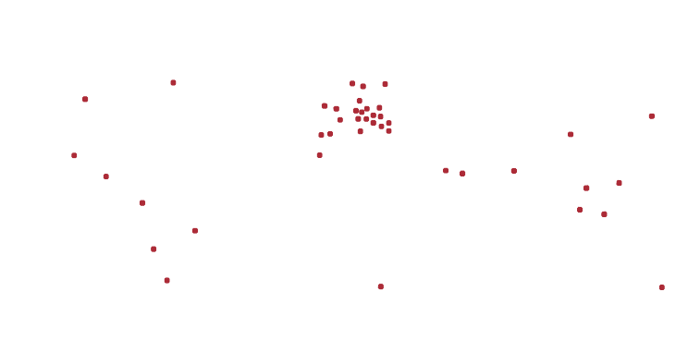


About Capgemini
With almost 145,000 people in over 40 countries, Capgemini is one of the world's foremost providers of consulting, technology and outsourcing services. The Group reported 2014 global revenues of EUR 10.573 billion.
Together with its clients, Capgemini creates and delivers business and technology solutions that fit their needs and drive the results they want. A deeply multicultural organization, Capgemini has developed its own way of working, the Collaborative Business Experience™, and draws on Rightshore®,
its worldwide delivery model.
Learn more about us at www.capgemini.com.
www.capgemini.com
The information contained in this presentation is proprietary. Copyright © 2015 Capgemini. All rights reserved. Rightshore® is a trademark belonging to Capgemini.

